Slide 1
Cirrhosis Patient Survival Prediction
P8108 Survival Analysis Final Project
Chen Liang, Jessie Li, Xinyi Shang, Ixtaccihuatl Obregon, Jane Ma

Slide 2
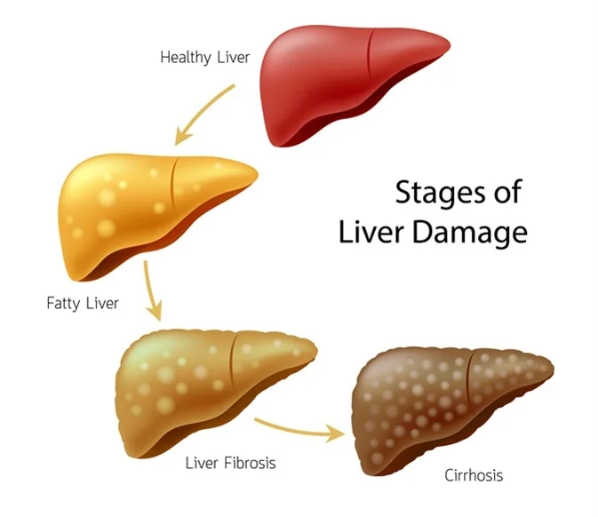
Cirrhosis
A condition in which the liver is scarred and permanently damaged.
Scar tissue replaces healthy liver tissue and prevents your liver from working normally. As cirrhosis gets worse, your liver begins to fail.
https://www.niddk.nih.gov/health-information/liver-disease/cirrhosis

Slide 3
Background
Dataset Overview
Source: UCI Machine Learning Repository
Purpose: Predict survival states of patients with biliary cirrhosis (PBC)
Study Period: 1974–1984
Institution: Mayo Clinic
Participants:
424 patients diagnosed with Primary Biliary Cirrhosis (PBC)
312 enrolled in a randomized, placebo-controlled trial testing D-penicillamine
112 did not participate in the trial but provided basic metrics and survival data
6 patients were lost to follow-up shortly after diagnosis
After drop missing values, there are 276 participants remaining in our analysis.
https://www.archive.ics.uci.edu/dataset/878/cirrhosis+patient+survival+prediction+dataset-1
Notes:
I find 276. Let me know if that’s correct (or not) -XS

Slide 4
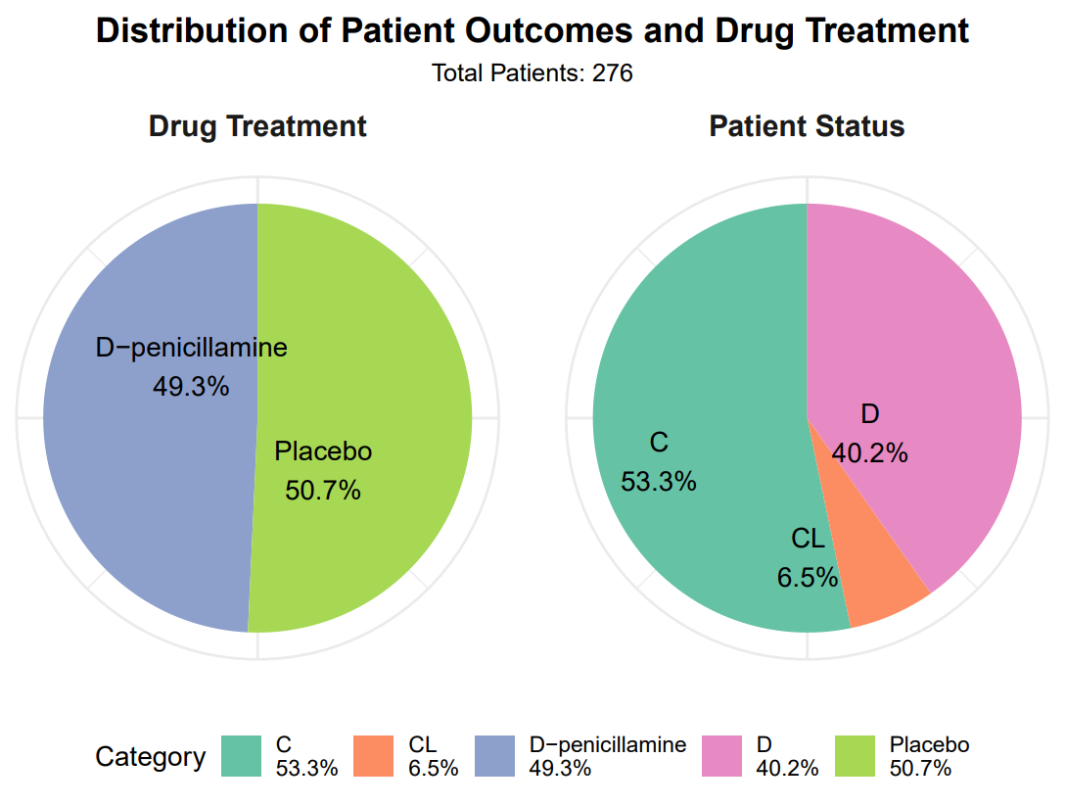
Total Instances: 276 patients (missing values are filtered out)
Features:
Demographics: Age, Sex
Clinical Indicators: Serum Bilirubin, Albumin, Alkaline Phosphatase, etc.
Symptoms: Presence of Ascites, Hepatomegaly, Spider angiomas, Edema
Laboratory Results: Cholesterol, Copper, SGOT, Triglycerides, Platelets, Prothrombin Time
Disease Stage: Histologic stage of disease (1 to 4)
Outcome:
Event: D (Death)
Censor: C (Censored) & CL (Censored due to liver transplantation)

Slide 5
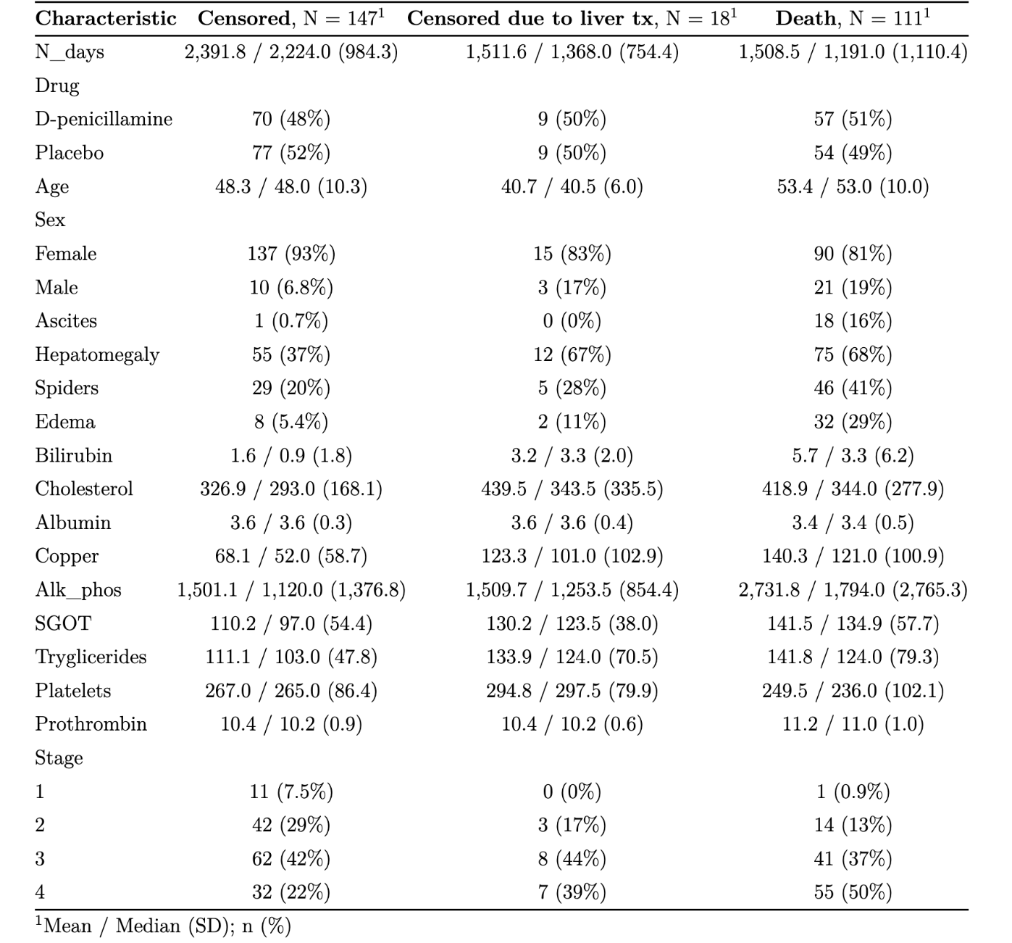
Baseline Statistics by Outcome Status

Slide 6
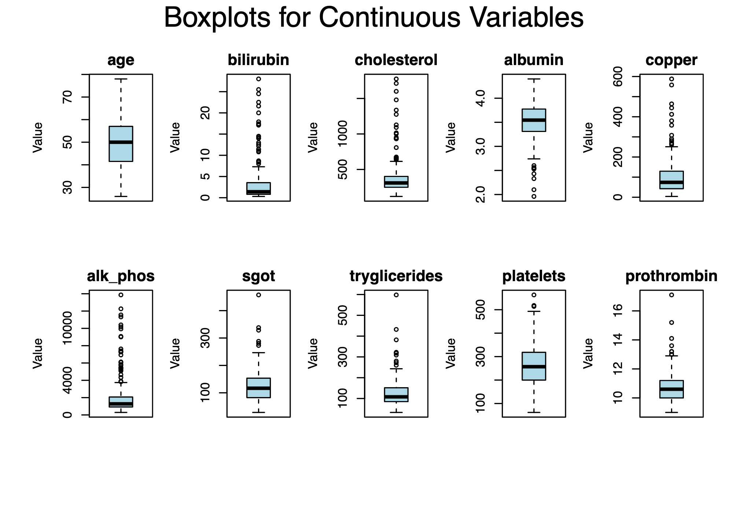
Exploratory Data Analysis
Box plots for continuous variables

Slide 7
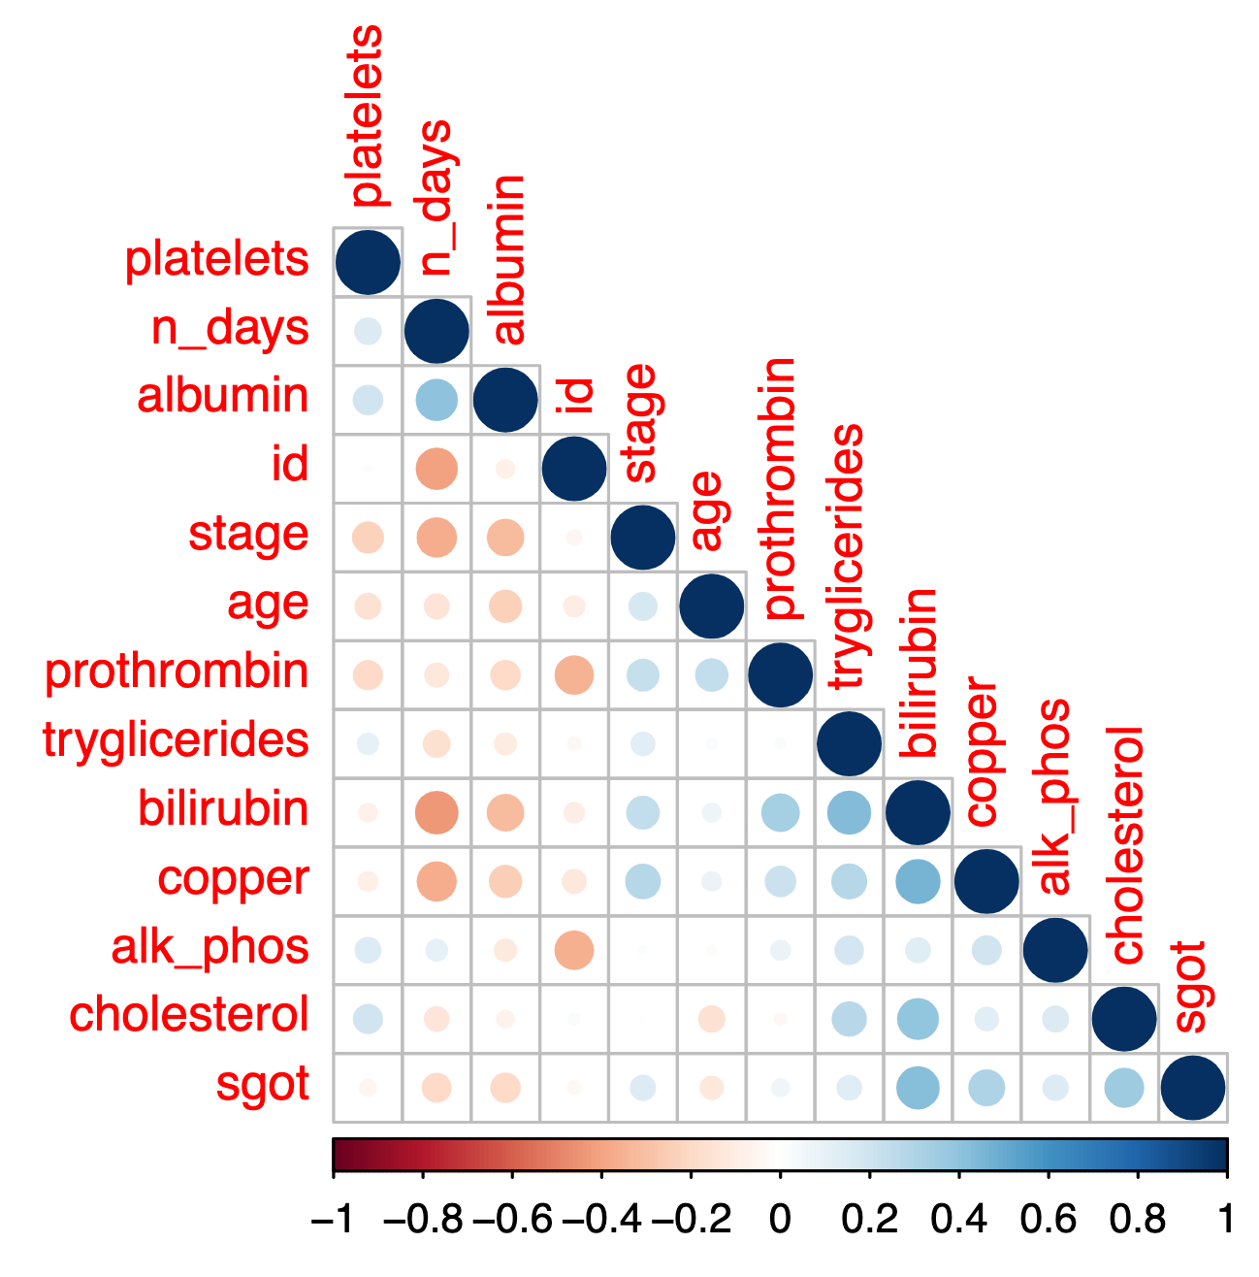
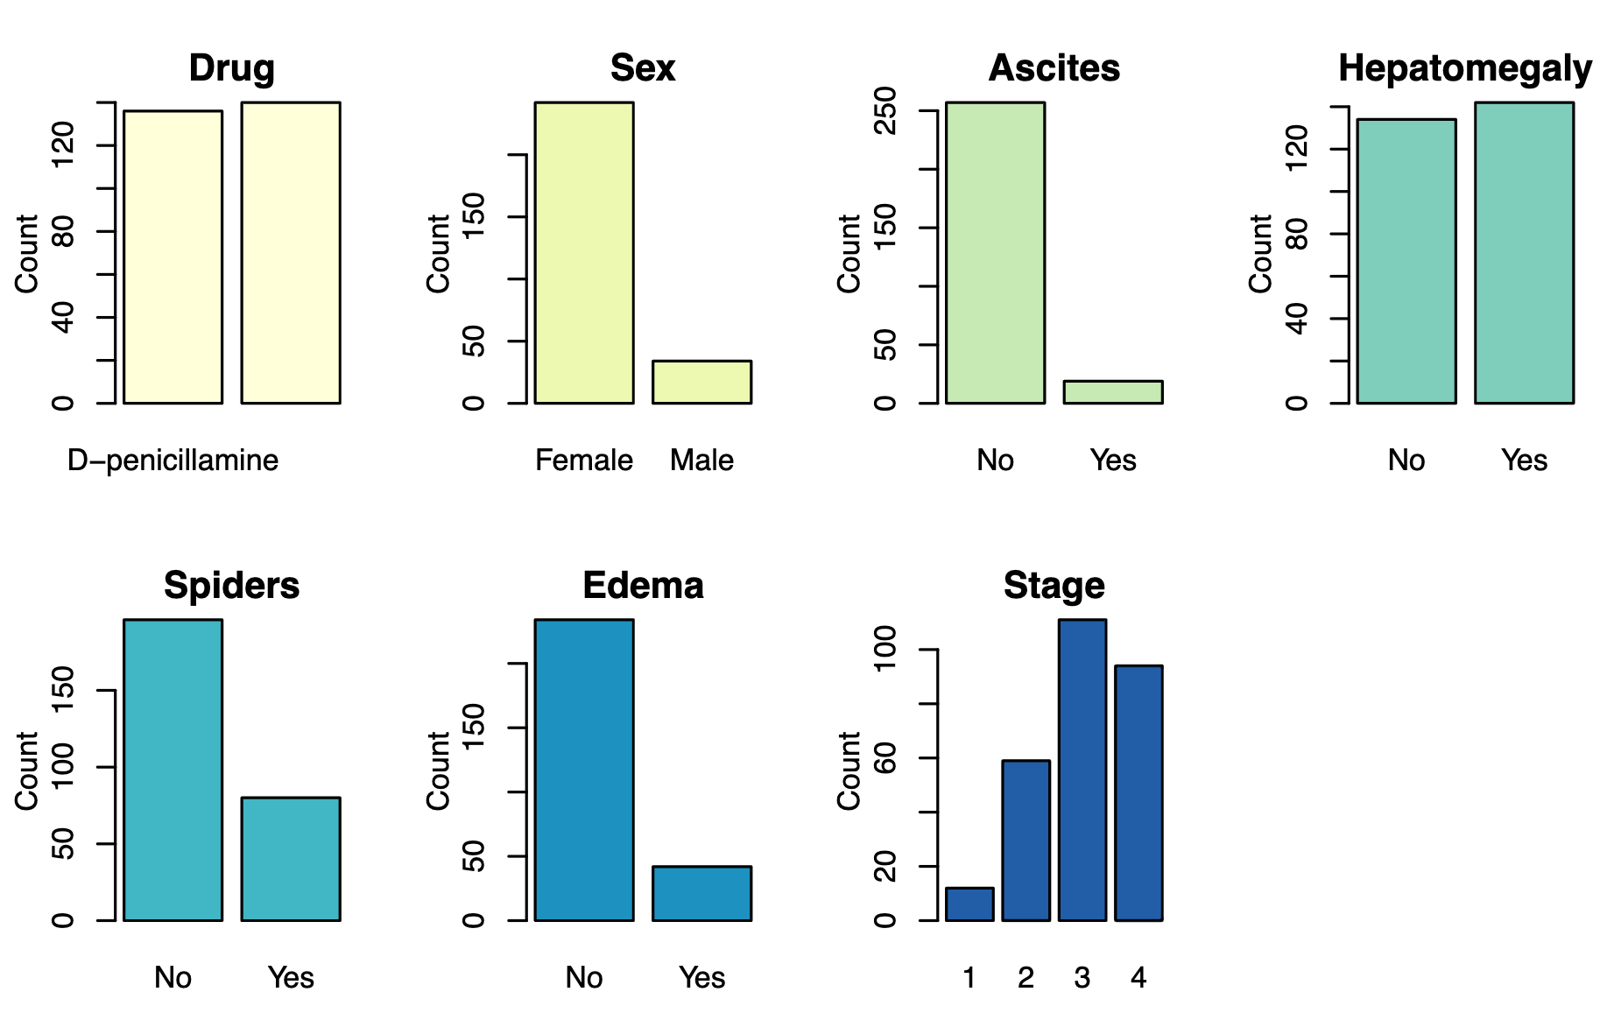
Exploratory Data Analysis
Bar plots for categorical variables
Correlation plot
Notes:
On the right, we see the correlation plot. It shows that there are no strong correlations between the variables, so we can treat them individually in our models.

Slide 8
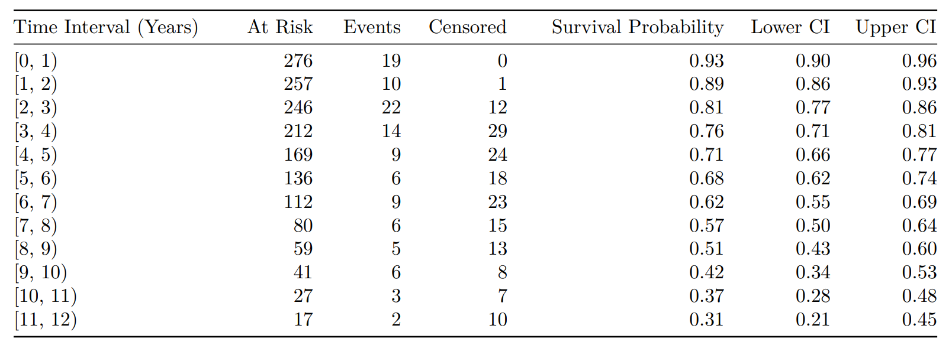
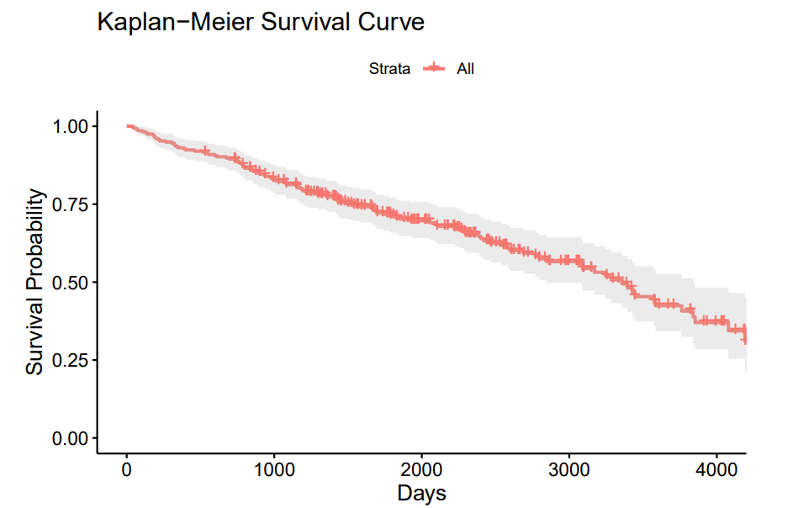
Kaplan Meier Survival Estimate
75% Survival time: ~4 years
50% Survival time: ~9 years
Notes:
Then we move to KM survival analysis, we constructed the life table and the survival curve for all the data. We observed the 75% survival time is around 4 years and median survival time to be around 9 years.

Slide 9
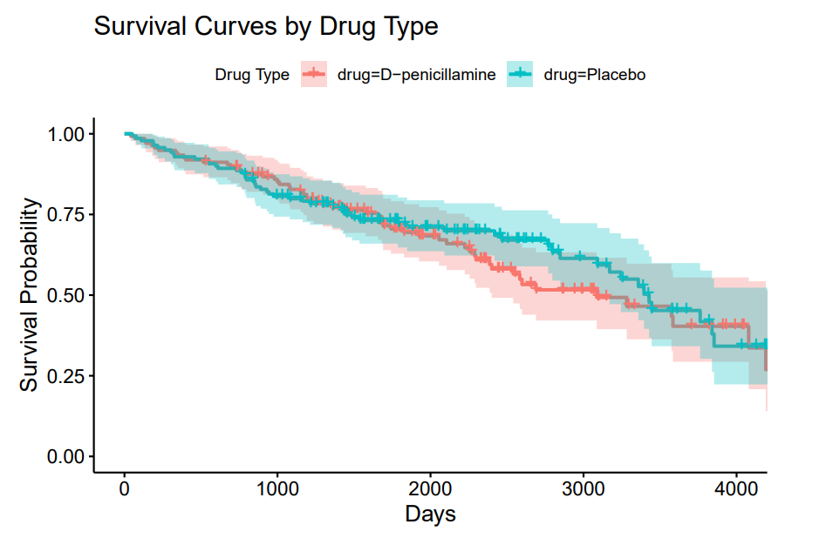

Kaplan Meier Survival Probability By Drug
Log Rank Test Result:
P-value: 0.5246 ( > 0.05)
Interpretation: No statistically significant difference in survival outcomes between the drug groups.
Conclusion: D-penicillamine does not demonstrate a statistically significant difference from the placebo group.
Notes:
Then we perform the analysis by drug group. There seems to be no significant differences between the placebo group and the D-penicillamine group in the survival curve. Additionally, we also checked the log rank test result. The P value is 0.5, which is way higher than the critical value 0.05. Thus, we can conclude there are no significant difference in survival outcomes between the drug groups, and D-penicillamine does not show significant differences from the placebo group.

Slide 10
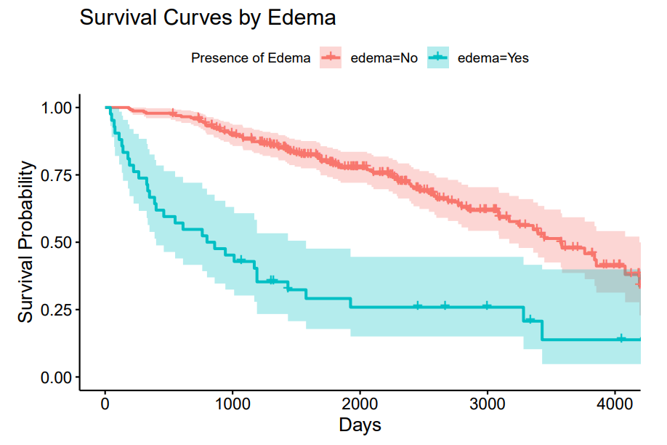
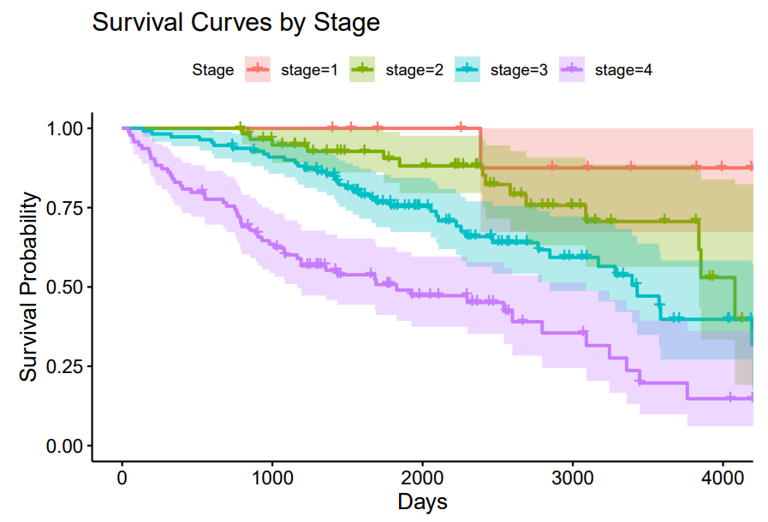


Kaplan Meier Survival Probability By Edema and Stage
Notes:
We also look at the survival outcome by other factors. We checked the survival curve and log rank test results of edema and disease stages. The presence of Edema has a significant influence in the outcome, showing by the survival curve and the extremely small p value. The stage of disease also shows a significant influence on the survival outcome with p<0.0001.
Edema is stratified later in the following analysis.

Slide 11
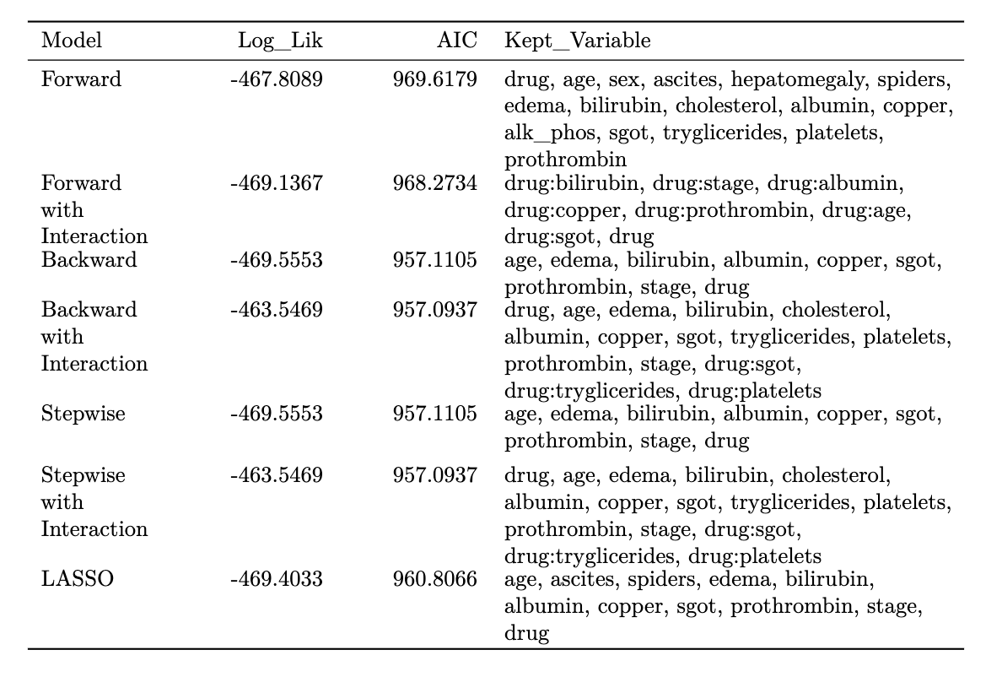
Feature
Selection
missing stage
Drug(primary variable of interest) is forced in final model
Used AIC as the criterion

Slide 12
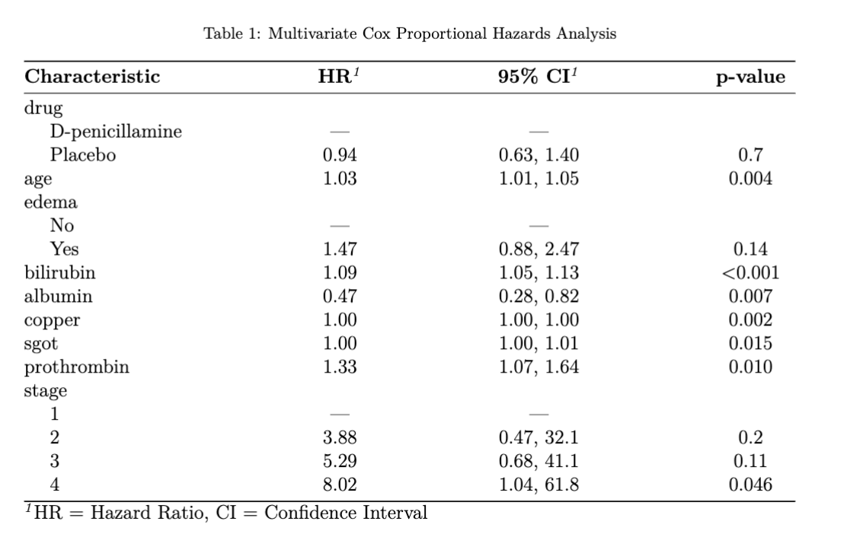
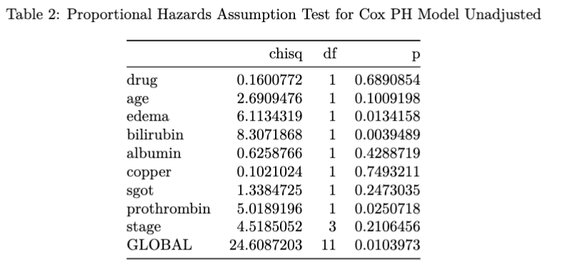
Cox Model
PH Assumption Violations:
Edema
Bilirubin
Prothrombin
If PH Assumptions are not met conduct:
A stratified analysis
Include a time-varying covariate to allow changing hazard ratios over time
Include interactions with time

Slide 13
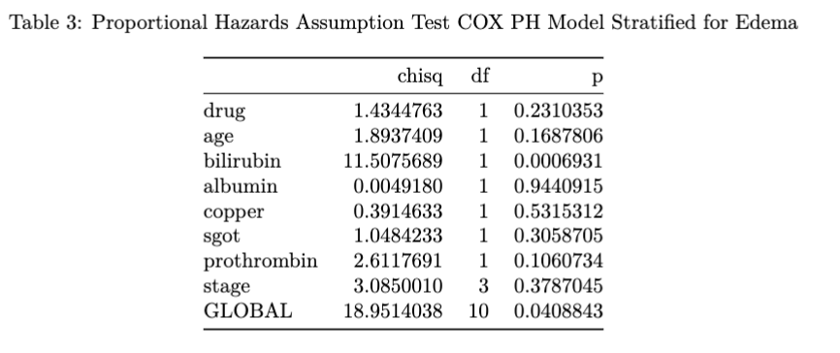
Stratification and Time-Varying
Stratification of Edema
PH Assumption Violations:
Bilirubin
Overall Model
Time Varying
Dataset did not contain observations of bilirubin or prothrombin at multiple time points.

Slide 14
Interaction with Time
Time Interaction for Bilirubin and Prohrombin
PH Assumption Violations:
Bilirubin
Time Interaction for Bilirubin
PH Assumption Violations:
Bilirubin
Time Interaction for Prohrombin
PH Assumption Violations:
Bilirubin
Prothrombin
Notes:
After the stratification we have the bilirubin left that violates the PH assumption so we consider adding an interaction with time for bilirubin. No need for prothrombin.
Because after the stratification, bilirubin violates the assumption. To deal with that, we add an interaction term with bilirubin and time.

Slide 15
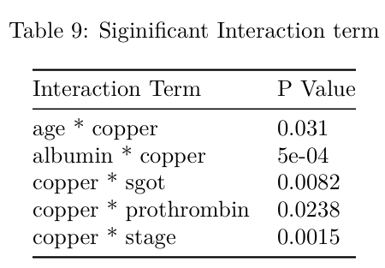
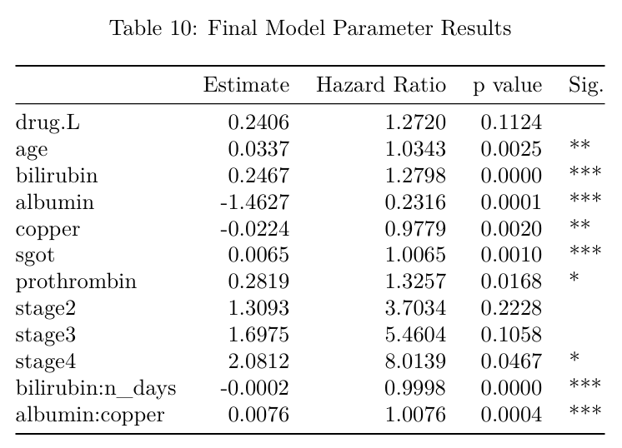
Interaction between Covariates
Final Cox Model
Use Likelihood Ratio Test
Procedure:
First step: add interaction between albumin and copper.
Second step: no interaction term is added.
Drug: insignificant negative survival impact
Significant Negative Impact on Survival:
Age, Bilirubin, SGOT, Prothrombin
Stage 4 compared with Stage 1
Albumin-Copper Interaction
Significant Positive Impact on Survival:
Albumin, Copper
Bilirubin-time Interaction
Notes:
Using the model stratified by edema and including the interaction term between bilirubin and time, we now consider the interaction between covariates. To do this, we use the LRT and select the interaction term with the lowest p value to be added to the model and repeat the procedure. Eventually, we added only the interaction term between albumin and copper.
Then, we have the final model as shown in the table here. The primary variable of interest - drug has a negative survival impact - but luckily it is insignificant. The covariates that have a significant negative impact on survival include …, and the interaction. The covariates that have a significant positive impact on survival include …

Slide 16
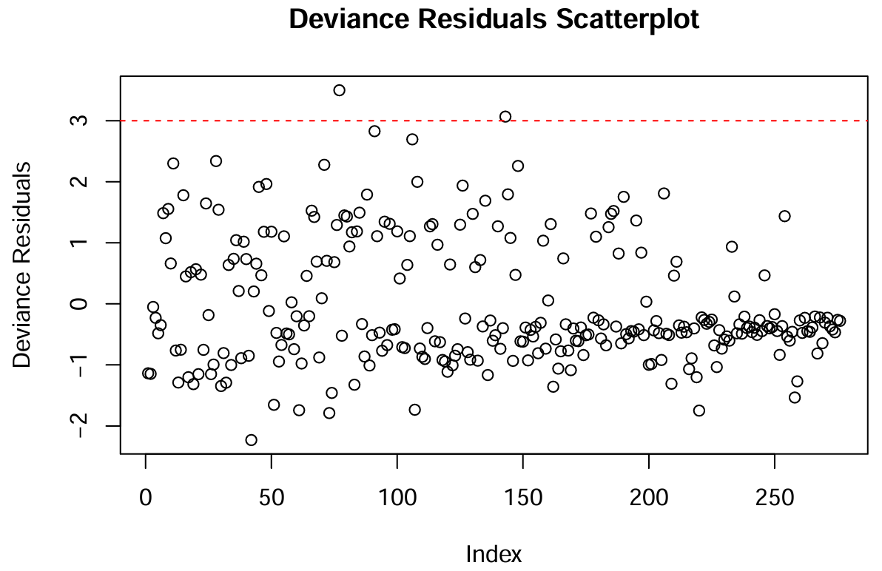
Model Evaluation
Residuals:
Deviance residuals: two outliers — 77 and 143.
Influence diagnostics:
LD option: 82, 100, 108, 129, 210
After dropping out:
Signs of coefficients stay the same.
Estimates are slightly different.
Notes:
Then, we can proceed to evaluate the model fit. The deviance residuals are randomly distributed around 0 and there are two outliers. Then, we use the influence diagnostics to identify influential individuals. With the LD option, the top five are 82, 100, 108, 129, 210. After dropping these outliers out, the signs stay the same while the estimates are slightly different.

Slide 17
Conclusion and Discussion
D-penicillamine is proved to be inefficient.
Age & Stage: Emphasize early detection and stage-specific care.
Bilirubin, Copper, SGOT, Prothrombin, Albumin: Monitor liver function and metabolic health closely.
The protective impact of copper: Copper deficiency is proved to be a risk factor for mortality in patients with advanced liver disease.
Interaction
Negative Albumin-Copper Interaction: a synergistic negative impact on survival.
Monitor High-Risk Patients
Conduct Biological Investigation
Investigate other interactions further for personalized treatments.

Slide 18
Limitation
Missing data: A total of 147 observations have missing values, which could be addressed through imputation techniques.
Imbalanced Data:
Unbalanced distribution of sex (80-90% female vs male)
Right-skewed distribution of Bilirubin
High censoring rate: More than 50% censored data

Slide 19
Thank You!

